Slide 1
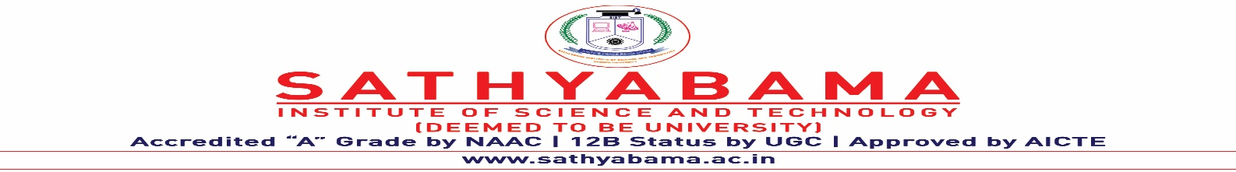
FRAUD DETECTION ECOSYSTEM USING MACHINE LEARNING ALGORITHMS ON INTERNET COMPUTER PROTOCOL
Under the guidance of
Dr. G Meeragandhi, Ph.D.,
by
Adari Vandik
(39110019)
Aluru Muniveda Indra Nikhil
(39110047)

Slide 2
Presentation Outline
Introduction
Motivation
Literature survey
Inferences from Literature Survey
Objectives
System Architecture
Description of Software for Implementation
Project Management Plan
References
Q&A

Slide 3
Introduction
To utilise the existing Machine Learning algorithms to discern the existing frauds in everyday life.
Fraud prediction scenario is taken.
To compare and perform different machine learning algorithms and approaches.
Data sets from Kaggle(news, credit cards, product reviews) are taken.
Visualisation of observed data.

Slide 4
Literature Review
AUTHOR | YEAR OF PUBLICATION | DESCRIPTIONS | PROS | CONS
Benarjee | 2017 | Predicting the housing price direction using machine learning techniques. | Used multiple techniques of classification | Not used regression and boosting of trees
Ghosalkar | 2018 | Real estate value prediction using linear regression | Used linear regression | Used only naïve method
Harrison,Jr | 1978 | Hedonic housing prices and the demand for clean air. | Hedonic study of internal and external factors | Limited method of less complexity

Slide 5
Literature Review
AUTHOR | YEAR OF PUBLICATION | DESCRIPTIONS | PROS | CONS
Lu.s | 2017 | A hybrid regression technique for house prices prediction | Used hybrid technique of Lasso and Gradient Boost | Not used classification
Ngheip | 2001 | A comparison of multiple regression analysis and artificial neural networks | Used SVM instead of linear regression | Used only one method
Shinde | 2018 | Survey on predicting property price | Used decision tree model | Less accuracy

Slide 6
Inferences from Literature Survey
We got to discover that scams and frauds have a broad spectrum and has limited observations as of now.
The anticipation of a scam/fraud are deliberately increasing particularly in the field of news,transactions and online shopping.
There is limited to no platforms that exist on the internet whose backend is secured by blockchain.

Slide 7
Objectives
To implement and contrast ML algorithms on news articles,product reviews, credit card transaction datasets.
To predict using regression, classification and sentimental (news,reviews) and feature analysis (credit card).
To distinguish genuinity from fraud and securing it using ICP chain.
To visualize the data distribution ,correlation and variance and inferring the relative best algorithm.

Slide 8
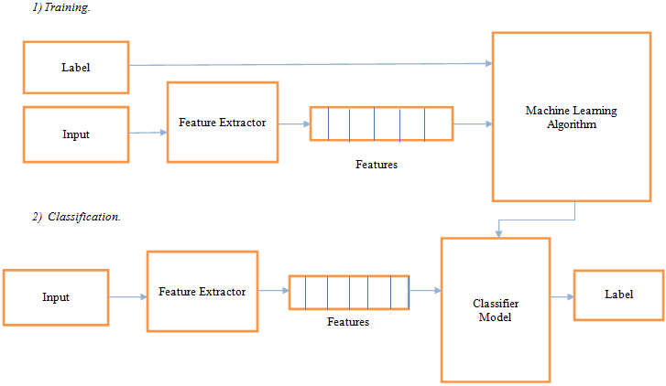
System Architecture

Slide 9
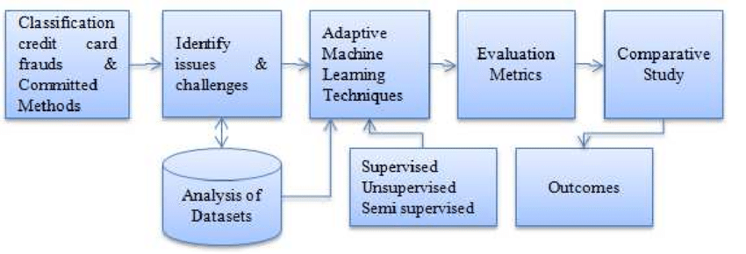
System architecture

Slide 10
Description of Software for Implementation
Designing a web page consists of form pages and result pages using html,css and javascript inorder to get the input from the user to predict or detect the fraud.
Website consists of fake news detection, fake review detection and credit card scam prediction.
Fake news and fake review predictions works on the principle of sentimental analysis. Sentiment analysis is the automated process of analyzing text to determine the sentiment expressed (positive, negative or neutral).
Credit card scam detection works on the principle of feature analysis. It is the process of automatically choosing relevant features for your machine learning model based on the type of problem you are trying to solve.
Entire ecosystem will be running on the ICP(Internet Computer Protocol) Chain where we burn the test tera cycles for each run/edit.

Slide 11
Project Management Plan
After defining the problem statement the steps that are followed are:
Collecting the data : Data is collected from the datasets which are received from various datasets providing platforms.
Data cleaning : A large part of the cleansing process includes making sure that the data is in a usable format. This entails searching for outliers, dealing with null values, and looking for data that may have been incorrectly input.
Feature Extracting : Extracting the features useful to the model from the variety.
Feature Engineering : Transforming raw data into numerical features that can be processed while preserving the information in the original data set.

Slide 12
Project Management Plan
Building the model : Design tests to determine how well your model works. For this, your deliverable will be your test design. This may entail splitting your data into training data and testing data to avoid overfitting using sentimental analysis or feature analysis.
Testing : Evaluate the model based on the goal. Then review the work process and explain how model will help the goal, summarizing the findings, and make any corrections.
Deployment : Process of putting machine learning models into production. This makes the model's predictions available to users, developers or systems, so they can make business decisions based on data, interact with their application.

Slide 13
References
[1] https://www.kaggle.com/code/madz2000/nlp-using-glove-embeddings-99- 87-accuracy
[2] Shagun Sharma; Anjali Kataria; Jasminder Kaur Sandhu; K. R. Ramkumar
https://ieeexplore.ieee.org/document/9824065
[3] Md Mahadi Hassan Sohan; Mohammad Monirujjaman Khan; Ipseeta Nanda; Rajesh Dey
https://ieeexplore.ieee.org/document/9817271
[4] Nihel Fatima Baarir; Abdelhamid Djeffal
https://ieeexplore.ieee.org/document/9378748
[5] A. Singh; G. Gupta
https://ieeexplore.ieee.org/document/9800422

Slide 14
THANK YOU
We thank our guide and panel and all technical and non technical staff helped us in achieving this.

